Slide 1
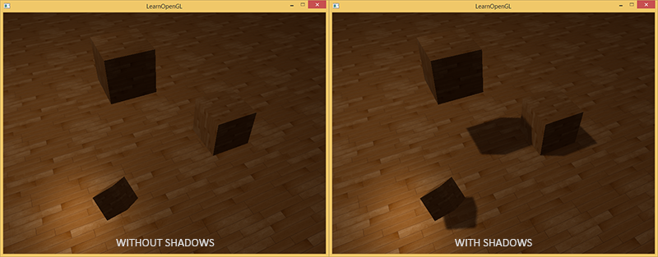
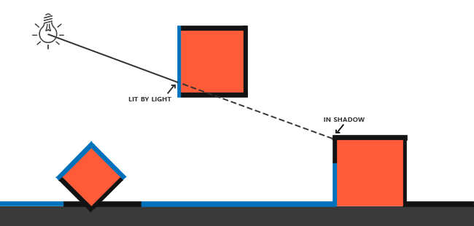
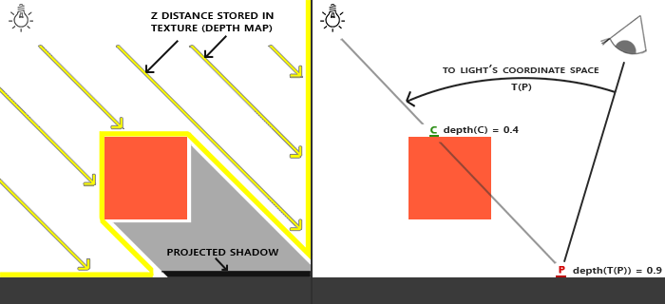
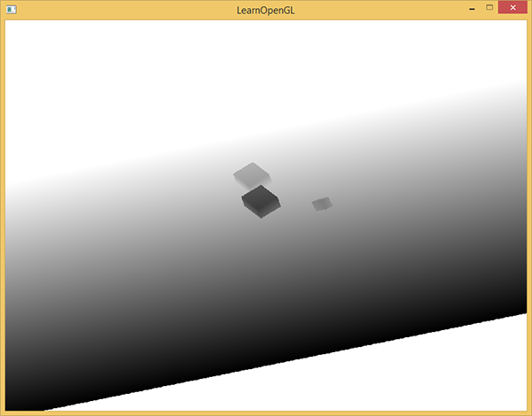
阴影映射（shadow mapping）
有阴影的时候你能更容易地区分出物体之间的位置关系
蓝线：光源可以照到的片段
黑线：被遮挡的片段
如果能知道从灯光的位置射到每一个片段的长度值就好了，这让我们很自然的想到了深度测试里的深度值。
深度贴图（depth map）
float ShadowCalculation(vec4 fragPosLightSpace) {
// perform perspective divide
vec3 projCoords = fragPosLightSpace.xyz / fragPosLightSpace.w;
// transform to [0,1] range
projCoords = projCoords * 0.5 + 0.5;
// get closest depth value from light's perspective (using [0,1] range fragPosLight as coords)
float closestDepth = texture(shadowMap, projCoords.xy).r;
// get depth of current fragment from light's perspective
float currentDepth = projCoords.z;
// check whether current frag pos is in shadow
float shadow = currentDepth > closestDepth ? 1.0 : 0.0;
return shadow;
}
ShadowCalculation计算结果为1，那么最终的漫反射和镜面光就给0

Slide 2
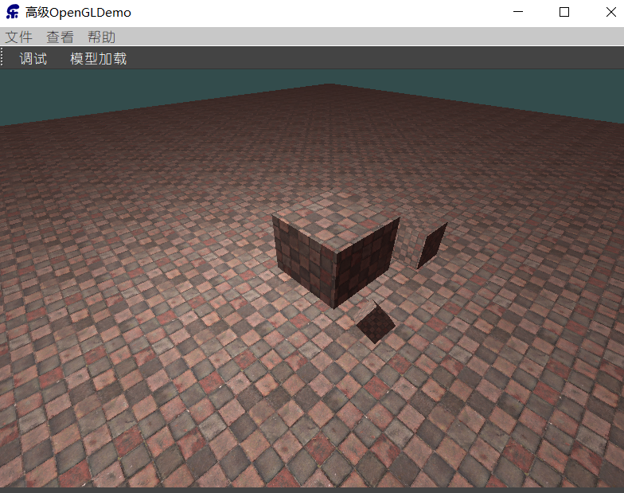
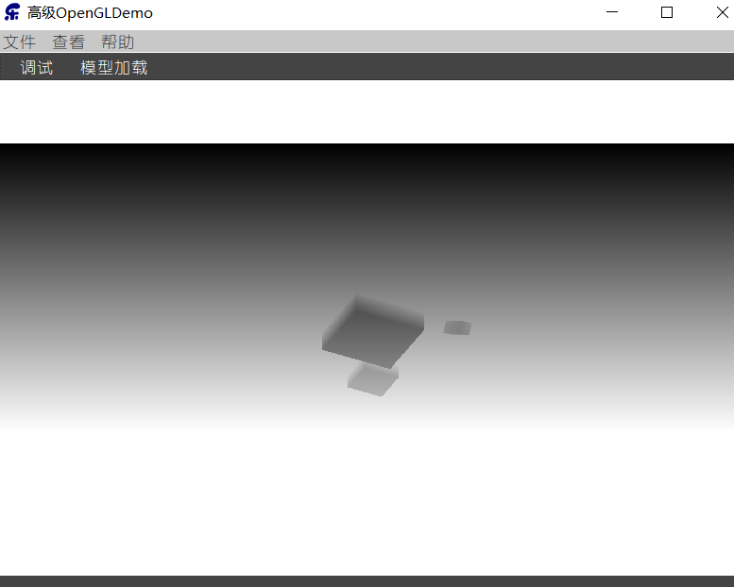
深度贴图
创建一个纹理，作为自定义帧缓冲的深度附件
将深度值渲染到自定义帧缓冲的深度附件
使用该纹理作为整个窗口的纹理
首先，我们要为渲染的深度贴图创建一个帧缓冲对象：
unsigned int depthMapFBO; glGenFramebuffers(1, &depthMapFBO);
然后，创建一个2D纹理：
const unsigned int SHADOW_WIDTH = 1024, SHADOW_HEIGHT = 1024;
unsigned int depthMap;
glGenTextures(1, &depthMap);
glBindTexture(GL_TEXTURE_2D, depthMap);
glTexImage2D(GL_TEXTURE_2D, 0, GL_DEPTH_COMPONENT, SHADOW_WIDTH,
SHADOW_HEIGHT, 0, GL_DEPTH_COMPONENT, GL_FLOAT, NULL);
glTexParameteri(GL_TEXTURE_2D, GL_TEXTURE_MIN_FILTER, GL_NEAREST);
glTexParameteri(GL_TEXTURE_2D, GL_TEXTURE_MAG_FILTER, GL_NEAREST);
glTexParameteri(GL_TEXTURE_2D, GL_TEXTURE_WRAP_S, GL_REPEAT);
glTexParameteri(GL_TEXTURE_2D, GL_TEXTURE_WRAP_T, GL_REPEAT);
glTexImage2D - OpenGL 4 Reference Pages (khronos.org)
将创建的纹理提供给帧缓冲作为深度附件：
glBindFramebuffer(GL_FRAMEBUFFER, depthMapFBO);
glFramebufferTexture2D(GL_FRAMEBUFFER, GL_DEPTH_ATTACHMENT,
GL_TEXTURE_2D, depthMap, 0);
glDrawBuffer(GL_NONE);
glReadBuffer(GL_NONE);
glBindFramebuffer(GL_FRAMEBUFFER, defaultFramebufferObject() );
显式告诉OpenGL我们不使用颜色数据进行渲染
配置完用帧缓冲后，我们就可以开始第一步了：生成深度贴图。
#version 330 core
layout (location = 0) in vec3 aPos;
uniform mat4 lightSpaceMatrix;
uniform mat4 model;
void main() {
gl_Position = lightSpaceMatrix * model * vec4(aPos, 1.0);
}
#version 330 core void main() {
// gl_FragDepth = gl_FragCoord.z;
}

Slide 3
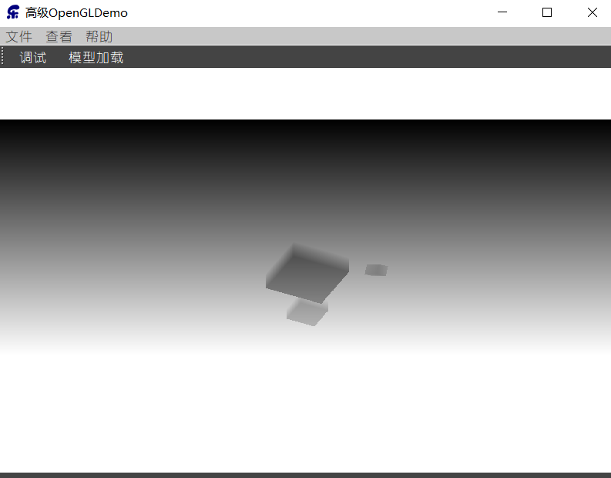
// 1. render depth of scene to texture (from light's perspective)
m_DepthMapShaderProgram.bind();
QMatrix4x4 lightProjection, lightView;
QMatrix4x4 lightSpaceMatrix;
float near_plane = 1.0f, far_plane = 7.5f;
lightProjection.ortho(-10.0f, 10.0f, -10.0f, 10.0f, near_plane, far_plane);
lightView.lookAt(lightPos, QVector3D(0.0f), QVector3D(0.0, 1.0, 0.0));
lightSpaceMatrix = lightProjection * lightView;
// render scene from light's point of view
m_DepthMapShaderProgram.setUniformValue("lightSpaceMatrix", lightSpaceMatrix);
glViewport(0, 0, SHADOW_WIDTH, SHADOW_HEIGHT); glBindFramebuffer(GL_FRAMEBUFFER, depthMapFBO);
glClear(GL_DEPTH_BUFFER_BIT);
renderScene(m_DepthMapShaderProgram);
m_DepthMapShaderProgram.release();
glBindFramebuffer(GL_FRAMEBUFFER, defaultFramebufferObject());
// reset viewport
glViewport(0, 0, width(), height());
glClear(GL_COLOR_BUFFER_BIT | GL_DEPTH_BUFFER_BIT);
// render Depth map to quad for visual debugging // ---------------------------------------------
m_QuadShaderProgram.bind();
renderQuad();
m_QuadShaderProgram.release();
#version 330 core
layout (location = 0) in vec3 aPos;
layout (location = 2) in vec2 aTexCoords;
out vec2 TexCoords;
void main() {
TexCoords = aTexCoords;
gl_Position = vec4(aPos, 1.0);
}
#version 330 core
out vec4 FragColor;
in vec2 TexCoords;
struct Material {
sampler2D texture_diffuse1;
};
uniform Material material;
uniform float near_plane;
uniform float far_plane;
// required when using a perspective projection matrix
float LinearizeDepth(float depth) {
float z = depth * 2.0 - 1.0; // Back to NDC
return (2.0 * near_plane * far_plane) / (far_plane + near_plane - z * (far_plane - near_plane));
}
void main() {
float depthValue = texture(material.texture_diffuse1, TexCoords).r;
// FragColor = vec4(vec3(LinearizeDepth(depthValue) / far_plane), 1.0); // perspective
FragColor = vec4(vec3(depthValue), 1.0); // orthographic
}

Slide 4
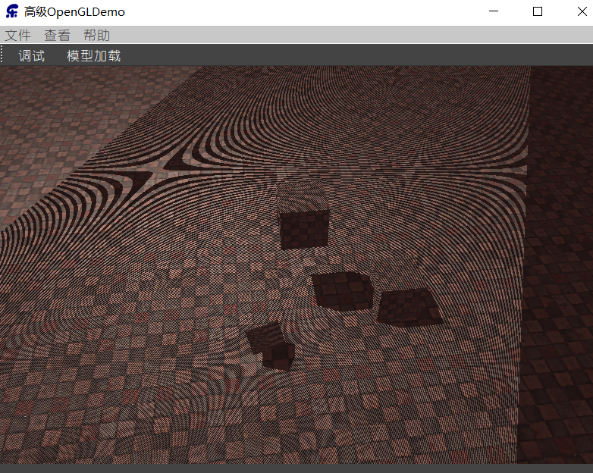
渲染阴影
生成深度贴图以后就可以开始生成阴影了
uniform sampler2D depthMap;
float ShadowCalculation(vec4 fragPosLightSpace) {
// perform perspective divide
vec3 projCoords = fragPosLightSpace.xyz / fragPosLightSpace.w;
// transform to [0,1] range
projCoords = projCoords * 0.5 + 0.5;
// get depth value from light's perspective (using [0,1] range fragPosLight as coords)
float closestDepth = texture(depthMap, projCoords.xy).r;
// get depth of current fragment from light's perspective
float currentDepth = projCoords.z;
// check whether current frag pos is in shadow
float shadow = currentDepth > closestDepth ? 1.0 : 0.0;
return shadow;
}
把光空间片段位置转换为裁切空间的标准化设备坐标
FragPosLightSpace is not passed to the fragment shader through gl_Position, we have to do this perspective divide ourselves
正交投影不需要这一步，但留着也没什么坏处
float shadow =ShadowCalculation(FragPosLightSpace);
vec3 result = (ambient + (1.0-shadow)*(diffuse+specular) );
FragColor = vec4(result, 1.0);
out vec4 FragPosLightSpace; uniform mat4 lightSpaceMatrix; void main() {
TexCoords=aTexCoords;
Normal = mat3(transpose(inverse(model))) * aNormal;
FragPos=vec3(model * vec4(aPos,1.0));
FragPosLightSpace = lightSpaceMatrix * vec4(FragPos, 1.0);
gl_Position = projection * view * vec4(FragPos, 1.0);
}

Slide 5
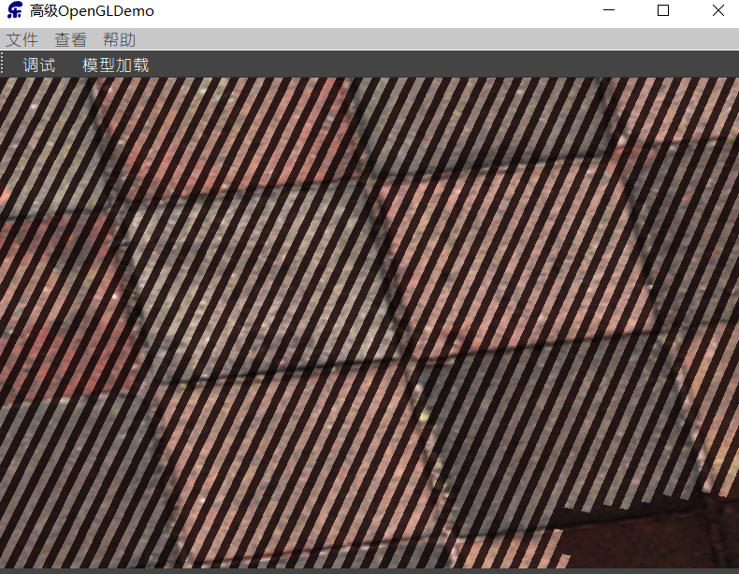
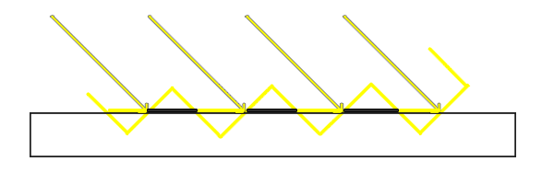
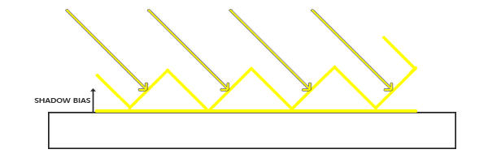
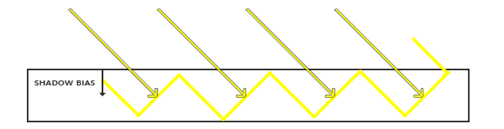
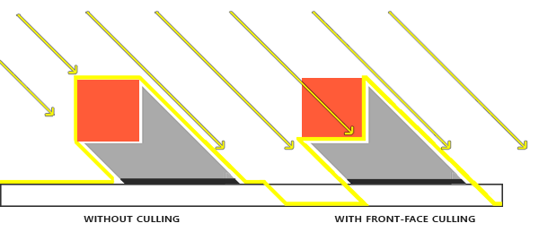
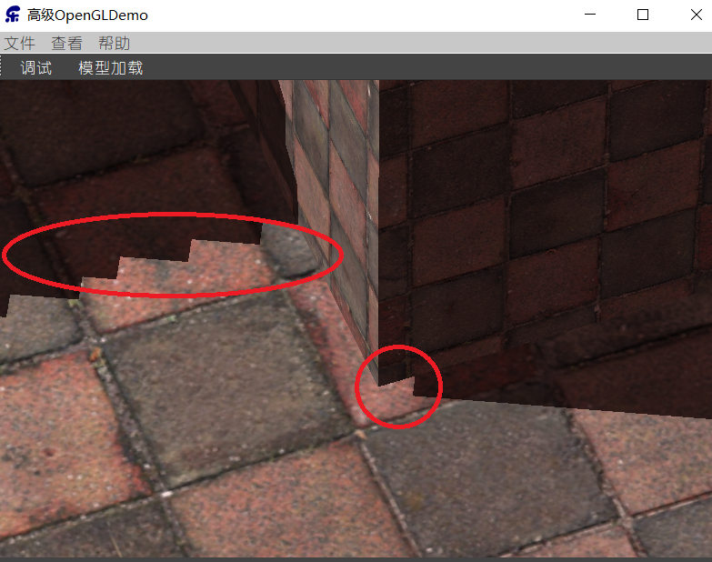
阴影效果改进
图片每个斜坡代表深度贴图一个单独的纹理像素
Shadow Acne
float bias = max(0.05 * (1.0 - dot(Normal, light.pos-FragPos)), 0.005);
float shadow = currentDepth - bias > closestDepth ? 1.0 : 0.0;
glEnable(GL_CULL_FACE);
glCullFace(GL_FRONT);
renderScene(&m_DepthMapShaderProgram);
glCullFace(GL_BACK); // 不要忘记设回原先的culling face
float near_plane = 1.0f, far_plane = 25.0f;
lightProjection.ortho(-25.0f, 25.0f, -25.0f, 25.0f, near_plane, far_plane);
二选一
if(projCoords.z > 1.0 || projCoords.x < 0.0 || projCoords.x > 1.0)
shadow = 0.0;
glTexParameteri(GL_TEXTURE_2D, GL_TEXTURE_WRAP_S, GL_CLAMP_TO_BORDER);
glTexParameteri(GL_TEXTURE_2D, GL_TEXTURE_WRAP_T, GL_CLAMP_TO_BORDER);
float borderColor[] = { 1.0f, 1.0f, 1.0f, 1.0f };
glTexParameterfv(GL_TEXTURE_2D, GL_TEXTURE_BORDER_COLOR, borderColor);
const unsigned int SHADOW_WIDTH = 10240, SHADOW_HEIGHT = 10240;
深度纹理精度不够
悬浮(Peter Panning)

Slide 6
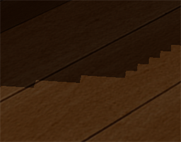
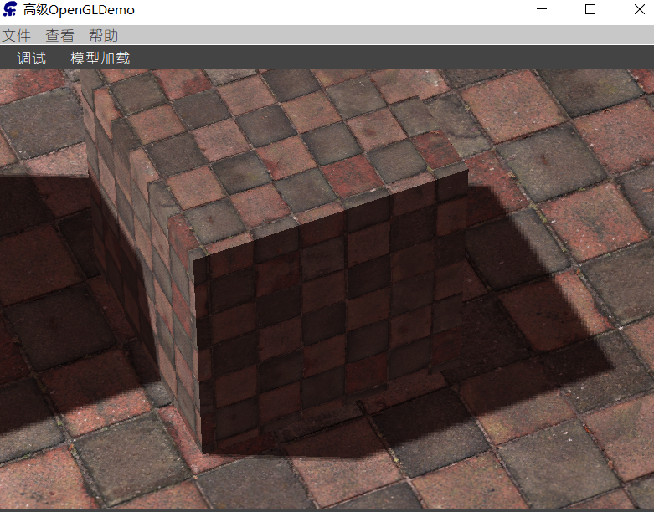
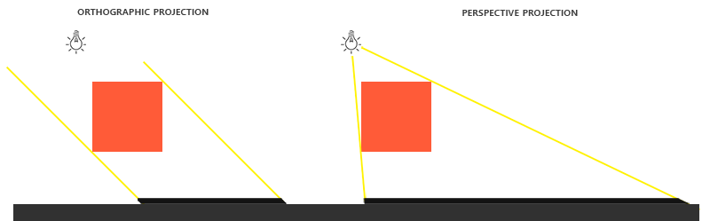
PCF（percentage-closer filtering）
深度贴图有一个固定的分辨率，多个片段对应于一个纹理像素。结果就是多个片段会从深度贴图的同一个纹理像素值进行采样，这几个片段便得到的是同一个阴影，这就会产生锯齿边。
PCF：核心思想是从深度贴图中多次采样，每一次采样的纹理坐标都稍有不同
一个简单的PCF的实现是简单的从纹理像素四周对深度贴图采样，然后把结果平均起来：
textureSize returns a vec2 of the width and height of the given sampler texture at mipmap level 0
float shadow = 0.0;
vec2 texelSize = 1.0 / textureSize(depthMap, 0);
for(int x = -1; x <= 1; ++x) {
for(int y = -1; y <= 1; ++y) {
float pcfDepth = texture(depthMap, projCoords.xy + vec2(x, y) * texelSize).r;
shadow += currentDepth - bias > pcfDepth ? 1.0 : 0.0;
}
}
shadow /= 9.0;
正交 vs 投影

Slide 7
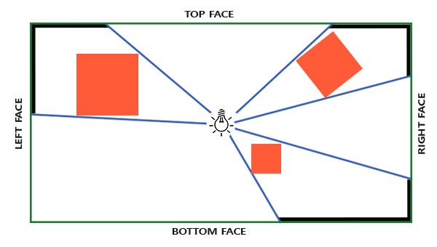
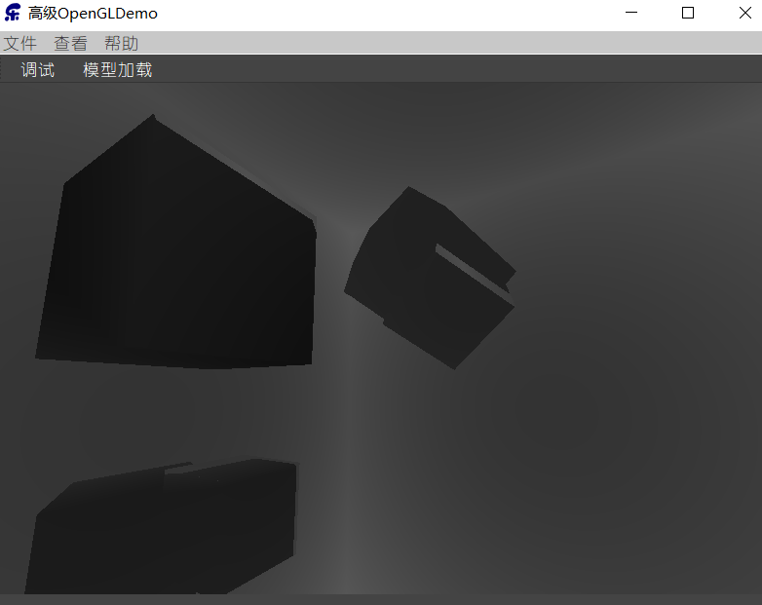
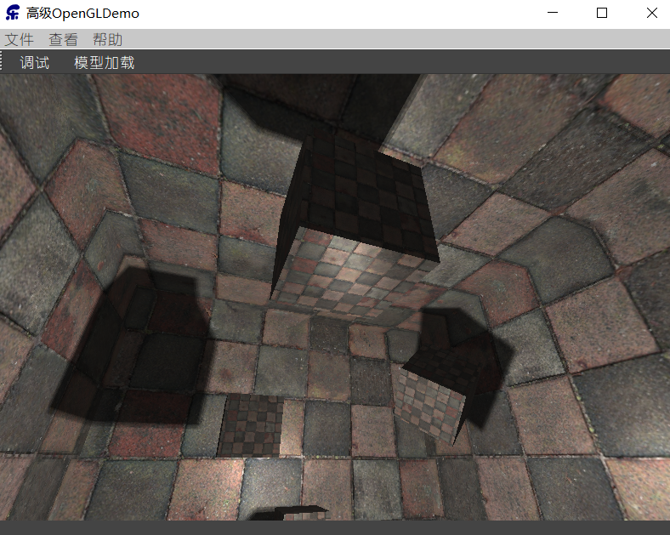
点光源阴影
生成深度立方体贴图
for(unsigned int i = 0; i < 6; i++) {
GLenum face = GL_TEXTURE_CUBE_MAP_POSITIVE_X + i; glFramebufferTexture2D(GL_FRAMEBUFFER, GL_DEPTH_ATTACHMENT, face, depthCubemap, 0);
BindViewMatrix(lightViewMatrices[i]);
RenderScene();
}
几何着色器允许我们使用一次渲染过程来建立深度立方体贴图。
首先，我们需要创建一个立方体贴图：
// configure depth map FBO // -----------------------
const unsigned int SHADOW_WIDTH = 1024, SHADOW_HEIGHT = 1024;
unsigned int depthMapFBO;
glGenFramebuffers(1, &depthMapFBO);
// create depth cubemap texture
unsigned int depthCubemap;
glGenTextures(1, &depthCubemap);
glBindTexture(GL_TEXTURE_CUBE_MAP, depthCubemap);
for (unsigned int i = 0; i < 6; ++i)
glTexImage2D(GL_TEXTURE_CUBE_MAP_POSITIVE_X + i, 0, GL_DEPTH_COMPONENT, SHADOW_WIDTH, SHADOW_HEIGHT, 0, GL_DEPTH_COMPONENT, GL_FLOAT, NULL);
glTexParameteri(GL_TEXTURE_CUBE_MAP, GL_TEXTURE_MAG_FILTER, GL_NEAREST);
glTexParameteri(GL_TEXTURE_CUBE_MAP, GL_TEXTURE_MIN_FILTER, GL_NEAREST);
glTexParameteri(GL_TEXTURE_CUBE_MAP, GL_TEXTURE_WRAP_S, GL_CLAMP_TO_EDGE);
glTexParameteri(GL_TEXTURE_CUBE_MAP, GL_TEXTURE_WRAP_T, GL_CLAMP_TO_EDGE);
glTexParameteri(GL_TEXTURE_CUBE_MAP, GL_TEXTURE_WRAP_R, GL_CLAMP_TO_EDGE);
// attach depth texture as FBO's depth buffer
glBindFramebuffer(GL_FRAMEBUFFER, depthMapFBO);
glFramebufferTexture(GL_FRAMEBUFFER, GL_DEPTH_ATTACHMENT, depthCubemap, 0);
glDrawBuffer(GL_NONE);
glReadBuffer(GL_NONE);
glBindFramebuffer(GL_FRAMEBUFFER, defaultFramebufferObject());
使用几何着色器，允许把所有面在一个过程渲染，可以使用glFramebufferTexture直接把立方体贴图附加成帧缓冲的深度附件

Slide 8
// 1. first render to depth cubemap
glViewport(0, 0, SHADOW_WIDTH, SHADOW_HEIGHT);
glBindFramebuffer(GL_FRAMEBUFFER, depthMapFBO);
glClear(GL_DEPTH_BUFFER_BIT);
ConfigureShaderAndMatrices();
RenderScene();
glBindFramebuffer(GL_FRAMEBUFFER, 0);
// 2. then render scene as normal with shadow mapping (using depth cubemap)
glViewport(0, 0, SCR_WIDTH, SCR_HEIGHT);
glClear(GL_COLOR_BUFFER_BIT | GL_DEPTH_BUFFER_BIT);
ConfigureShaderAndMatrices();
glBindTexture(GL_TEXTURE_CUBE_MAP, depthCubemap);
RenderScene();
光空间的变换
每个光空间变换矩阵使用同样的投影矩阵：
float aspect = (float)SHADOW_WIDTH/(float)SHADOW_HEIGHT;
float near = 1.0f;
float far = 25.0f;
QMatrix4x4 shadowProj ;
shadowProj.perspective(90.0f, aspect, near, far);
为每个方向提供一个不同的视图矩阵。右、左、上、下、近、远：
// 0. create depth cubemap transformation matrices // -----------------------------------------------
float near_plane = 1.0f;
float far_plane = 25.0f;
QMatrix4x4 shadowProj;
QMatrix4x4 shadowView;
shadowProj.perspective(90.0f, (float)SHADOW_WIDTH / (float)SHADOW_HEIGHT, near_plane, far_plane);
std::vector<QMatrix4x4> shadowTransforms;
shadowView.lookAt(lightPos, lightPos + QVector3D( 1.0, 0.0, 0.0), QVector3D(0.0,-1.0, 0.0));
shadowTransforms.push_back(shadowProj * shadowView); shadowView.setToIdentity();
shadowView.lookAt(lightPos, lightPos + QVector3D(-1.0, 0.0, 0.0), QVector3D(0.0,-1.0, 0.0));
shadowTransforms.push_back(shadowProj * shadowView); shadowView.setToIdentity();
shadowView.lookAt(lightPos, lightPos + QVector3D( 0.0, 1.0, 0.0), QVector3D(0.0, 0.0, 1.0));
shadowTransforms.push_back(shadowProj * shadowView); shadowView.setToIdentity();
shadowView.lookAt(lightPos, lightPos + QVector3D( 0.0,-1.0, 0.0), QVector3D(0.0, 0.0,-1.0));
shadowTransforms.push_back(shadowProj * shadowView); shadowView.setToIdentity();
shadowView.lookAt(lightPos, lightPos + QVector3D( 0.0, 0.0, 1.0), QVector3D(0.0,-1.0, 0.0));
shadowTransforms.push_back(shadowProj * shadowView); shadowView.setToIdentity();
shadowView.lookAt(lightPos, lightPos + QVector3D( 0.0, 0.0,-1.0), QVector3D(0.0,-1.0, 0.0));
shadowTransforms.push_back(shadowProj * shadowView);

Slide 9
渲染深度纹理的着色器
顶点着色器：简单地将顶点变换到世界空间，然后直接发送到几何着色器：
#version 330 core layout (location = 0) in vec3 aPos;
uniform mat4 model;
void main() {
gl_Position = model * vec4(aPos, 1.0);
}
几何着色器：以三角形的顶点作为输入:
#version 330 core layout (triangles) in;
layout (triangle_strip, max_vertices=18) out;
uniform mat4 shadowMatrices[6];
out vec4 FragPos; // FragPos from GS (output per emitvertex)
void main() {
for(int face = 0; face < 6; ++face) {
gl_Layer = face; // built-in variable that specifies to which face we render.
for(int i = 0; i < 3; ++i) // for each triangle vertex
{
FragPos = gl_in[i].gl_Position;
gl_Position = shadowMatrices[face] * FragPos;
EmitVertex();
}
EndPrimitive();
}
}
片段着色器：计算深度值，深度就是每个fragment位置和光源位置之间的线性距离
#version 330 core
in vec4 FragPos; uniform vec3 lightPos;
uniform float far_plane; void main() {
float lightDistance = length(FragPos.xyz - lightPos); // map to [0;1] range by dividing by far_plane
lightDistance = lightDistance / far_plane; // write this as modified depth
gl_FragDepth = lightDistance;
}

Slide 10
渲染深度纹理
所有事情都做好了，是时候来渲染深度纹理了：
glViewport(0, 0, SHADOW_WIDTH, SHADOW_HEIGHT);
glClear(GL_COLOR_BUFFER_BIT | GL_DEPTH_BUFFER_BIT);
m_DepthMapShaderProgram.bind();
// ... send uniforms to shader (including light's far_plane value) glActiveTexture(GL_TEXTURE0);
glBindTexture(GL_TEXTURE_CUBE_MAP, depthCubemap);
RenderScene(m_DepthMapShaderProgram);
最终场景输出的着色器
#version 330 core
layout (location = 0) in vec3 aPos;
layout (location = 1) in vec3 aNormal;
layout (location = 2) in vec2 aTexCoords;
out vec2 TexCoords;
out VS_OUT { vec3 FragPos; vec3 Normal; vec2 TexCoords; } vs_out;
uniform mat4 projection;
uniform mat4 view;
uniform mat4 model;
uniform bool reverse_normals;
void main() {
vs_out.FragPos = vec3(model * vec4(aPos, 1.0));
// make sure the outer large cube displays lighting from the 'inside
if(reverse_normals)
vs_out.Normal = transpose(inverse(mat3(model))) * (-1.0 * aNormal);
else
vs_out.Normal = transpose(inverse(mat3(model))) * aNormal;
vs_out.TexCoords = aTexCoords;
gl_Position = projection * view * model * vec4(aPos, 1.0);
}
float ShadowCalculation(vec3 fragPos) {
// get vector between fragment position and light position
vec3 fragToLight = fragPos - lightPos;
// ise the fragment to light vector to sample from the depth map
float closestDepth = texture(depthMap, fragToLight).r;
// it is in linear range between [0,1], let's re-transform it back to original depth value
closestDepth *= far_plane;
// now get current linear depth as the length between the fragment and light position
float currentDepth = length(fragToLight);
// test for shadows
float bias = 0.05;
// we use a much larger bias since depth is now in [near_plane, far_plane] range
float shadow = currentDepth - bias > closestDepth ? 1.0 : 0.0;
// display closestDepth as debug (to visualize depth cubemap)
// FragColor = vec4(vec3(closestDepth / far_plane), 1.0);
return shadow;
}

Slide 11
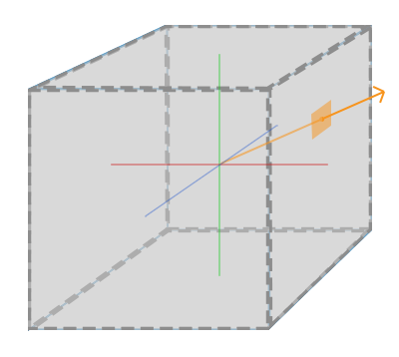
点光源的PCF
如果你放大到足够近，可以再次看到锯齿状边缘。PCF允许通过采样片段位置周围的多个样本并平均结果来平滑这些锯齿状边缘。
float shadow = 0.0;
float bias = 0.05;
float samples = 4.0;
float offset = 0.1;
for(float x = -offset; x < offset; x += offset / (samples * 0.5)) {
for(float y = -offset; y < offset; y += offset / (samples * 0.5)) {
for(float z = -offset; z < offset; z += offset / (samples * 0.5)) {
float closestDepth = texture(depthMap, fragToLight + vec3(x, y, z)).r;
closestDepth *= far_plane; // undo mapping [0;1]
if(currentDepth - bias > closestDepth) shadow += 1.0;
}
}
}
shadow /= (samples * samples * samples);
然而，samples设置为4.0，每个fragment我们会得到总共64个样本，这太多了
vec3 sampleOffsetDirections[20] = vec3[] (
vec3( 1, 1, 1), vec3( 1, -1, 1), vec3(-1, -1, 1), vec3(-1, 1, 1),
vec3( 1, 1, -1), vec3( 1, -1, -1), vec3(-1, -1, -1), vec3(-1, 1, -1),
vec3( 1, 1, 0), vec3( 1, -1, 0), vec3(-1, -1, 0), vec3(-1, 1, 0),
vec3( 1, 0, 1), vec3(-1, 0, 1), vec3( 1, 0, -1), vec3(-1, 0, -1),
vec3( 0, 1, 1), vec3( 0, -1, 1), vec3( 0, -1, -1), vec3( 0, 1, -1)
);
float shadow = 0.0;
float bias = 0.15;
int samples = 20;
float viewDistance = length(viewPos - fragPos);
float diskRadius = 0.05;
for(int i = 0; i < samples; ++i) {
float closestDepth=texture(depthMap, fragToLight + sampleOffsetDirections[i] * diskRadius).r;
closestDepth *= far_plane; // undo mapping [0;1]
if(currentDepth - bias > closestDepth) shadow += 1.0;
}
shadow /= float(samples);
change diskRadius based on the distance of the viewer to the fragment, making the shadows softer when far away and sharper when close by.
float diskRadius = (1.0 + (viewDistance / far_plane)) / 25.0;

